Slide 1


KIT End of Year
2023-2024

Slide 2
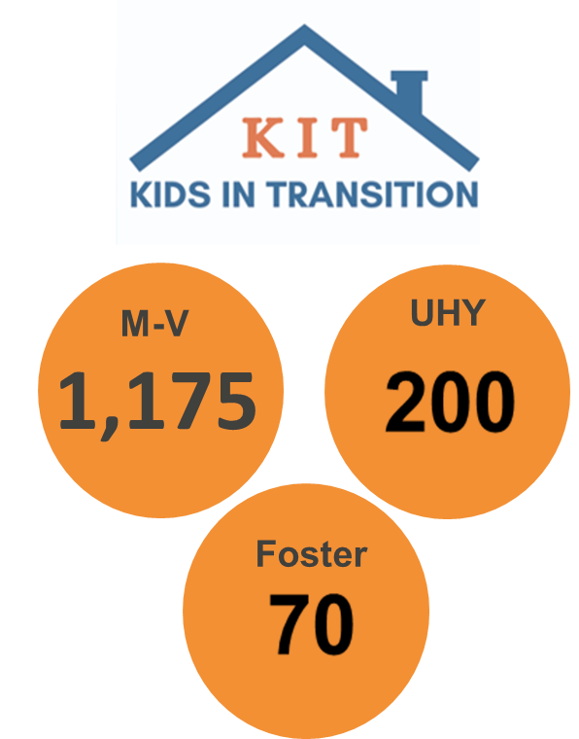
Today’s goals
Wrapping up the school year
Removing, Continuing, Transitions and Checking in
Summer
Summer school
Preparing for start of school 2024-2025
Address updates
Share data
Graduating Seniors
Final building lists coming soon
Staffing and Supports
Transportation
New Enrollment
McKinney-Vento and
Foster Education Support
Amy Perusse
EPS KIT Coordinator
McKinney-Vento Liaison
Abby Mayers
Foster Liaison/Family and Community Engagement Coordinator
Lyn Lauzon
Family Resource Center Coordinator
Diane Indivero
KIT Admin Assistant
Notes:
The McKinney-Vento Act has been around since 1987 and was most recently amended in 2015 as part of the Every Student Succeeds Act.
The most prominent changes of ESSA in the work we do was clarification of preschool eligibility, school and district of origin rights, and the addition of a parallel support Foster education program.
Our state has added in State Law that all public schools must have a building point of contact in each building.

Slide 3


KIT Overview
KIT Total
so far for 23-24
1,600
M-V Total
1,528
Foster
Only Total
54
M-V & Foster (Dual support)
Total
18
UHY
319
McKinney-Vento
Children & Youth who lack a fixed, regular, and adequate nighttime residence
Unaccompanied Homeless Youth (UHY)
Meet the McKinney-Vento definition and are not in the physical custody of a parent/guardian.
Foster Care
Substitute care away from home/parent and Child Welfare Agency has Placement, care, & authority

Slide 4
Kids in Transition
1,600 Identified and supported so far

Slide 5
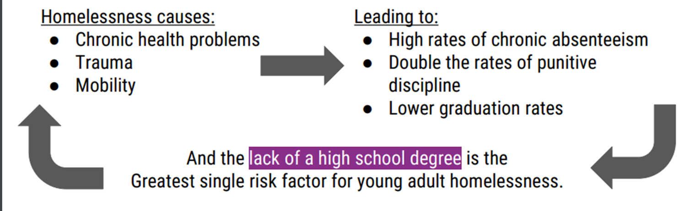
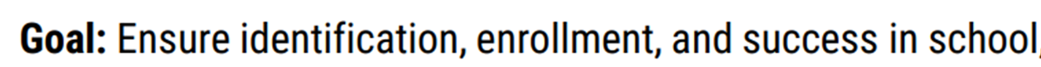
Kids in Transition
Why Educational Support?
Lack of stable housing causes:

Slide 6
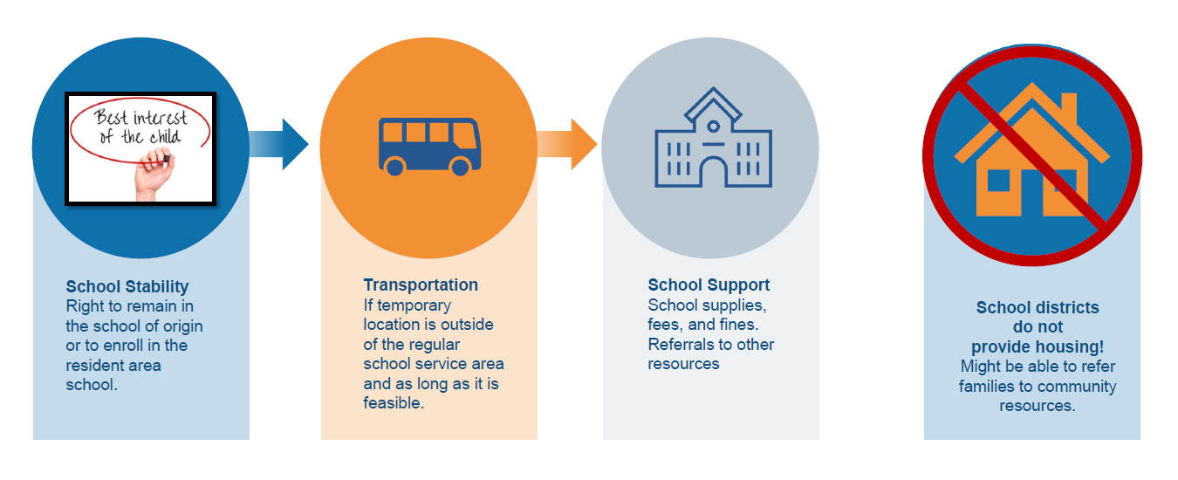

Slide 7

How long does KIT support last?
Once a student is stably housed (or no longer in foster care), they are eligible for support through the end of that school year and includes summer school if needed.
Students may enroll in their resident area school at any time. We encourage transferring at a “natural transition time” like over spring, winter, or summer break.
At registration in the new school, a parent should alert the new school if they are now stable but would like to finish the school year with support (this can be noted on the student housing form).

Slide 8

End of Year Check ins (In process- Final Lists next week)
Changes to contacts or housing?
Report to the KIT office using a student housing questionnaire
Summer school?
Notify the KIT office if KIT students need transportation out of the regular service area
School plan for fall?
Review the school decision making guide with staff, parents, caregivers, student
Foster, check in with Abby to make sure there is a good plan for fall if unsure
When contacting the KIT office, please either use the KIT office email (kitoffice@everettsd.org) or email Amy and Diane. Please do not do both!

Slide 9

Graduating Seniors
Fines & Fees
ASB treasurer can send eligible expenses to the KIT office to clear for graduating seniors.
UHY/Foster (& Former Foster)
Can complete (or amend) their FAFSA to apply as independent student.
Also, may have access to other financial aid and scholarships & programs like ETV & Onward Learning.
Cap & Gown, lists should have already been sent to the KIT office and we have paid for these through the vendors.

Slide 10

Summer
KIT Office is staffed year round
KITOffice@everettsd.org
425-385-4032
Transportation for out of area for Summer school programs
Support on site planned through our Cocoon House advocates
Sun Bucks- Program through DSHS
Summer Meal sites
FRCs also staffed
Low Cost/No cost summer activities will be posted on the KIT website soon

Slide 11

Preparing for Fall Start
We are removing over 400 students from our KIT program at the end of this school year.
New students are being screened for eligibility as they enroll and as the school staff get more details at the start of the school year.
Transportation requests are being sent to transportation departments starting in August and are adjusted as KIT students report changes.
Transportation departments are VERY busy at the start of the year and new requests take longer than usual to route.
Notes:
Can request items only or request a meeting with the Family Resource Coordinator

Slide 12
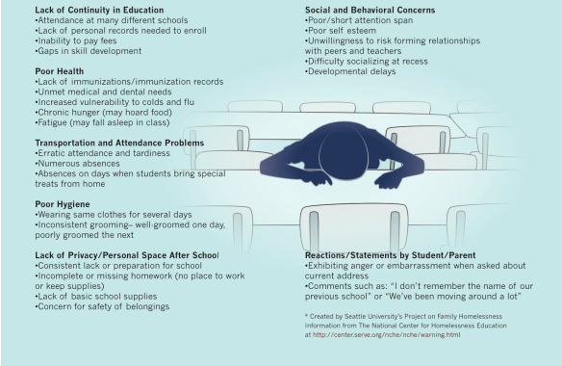
Possible indicators of housing instability
Notes:
Can request items only or request a meeting with the Family Resource Coordinator

Slide 13
Review of KIT Team
KIT Office:
Amy Perusse, KIT Coordinator x4235
Abby Mayers, Foster/Family and Community Engagement Coordinator x4138
Diane Indivero, KIT Office Assistant x4086
Family Resource Center- by referral only
Lyn Lauzon, Family Resource Coordinator x4654
Support Staff:
Mike Keiss, On-Time Graduation Success Coordinator x4535 (M,T,F); x5148 (W,Th)
Chris Fulford, Director Categorical Programs x4030
More information at www.everettsd.org/KIT (Sign in as an employee to unlock the KIT Staff Toolkit)

Slide 14


Slide 15

THANK
YOU!
For all you do to support EPS students
and families

